Slide 1
CSCE 3110
Data Structures &
Algorithm Analysis
Rada Mihalcea
http://www.cs.unt.edu/~rada/CSCE3110
Algorithm Analysis II
Reading: Weiss, chap. 2

Slide 2

Last Time
Steps in problem solving
Algorithm analysis
  Space complexity
  Time complexity
  Pseudo-code

Slide 3
Algorithm Analysis
Last time:
  Experimental approach – problems
  Low level analysis – count operations
Abstract even further
Characterize an algorithm as a function of the “problem size”
E.g.
  Input data = array → problem size is N (length of array)
  Input data = matrix → problem size is N x M

Slide 4


Asymptotic Notation
Goal: to simplify analysis by getting rid of unneeded information (like “rounding” 1,000,001≈1,000,000)
We want to say in a formal way 3n² ≈ n²
The “Big-Oh” Notation:
  given functions f(n) and g(n), we say that f(n) is O(g(n)) if and only if there are positive constants c and n₀ such that f(n)≤ c g(n) for n ≥ n₀

Slide 5


Graphic Illustration
f(n) = 2n+6
Conf. def:
  Need to find a function g(n) and a const. c such as f(n) < cg(n)
g(n) = n and c = 4
→ f(n) is O(n)
The order of f(n) is n
c g
(
n
)
=
4
n
g
(
n
)
=
n
n

Slide 6
More examples
What about f(n) = 4n² ? Is it O(n)?
  Find a c such that 4n² < cn for any n > n0
50n³ + 20n + 4 is O(n³)
  Would be correct to say is O(n³+n)
    Not useful, as n³ exceeds by far n, for large values
  Would be correct to say is O(n⁵)
    OK, but g(n) should be as closed as possible to f(n)
3log(n) + log (log (n)) = O( ? )
Simple Rule: Drop lower order terms and constant factors

Slide 7
Properties of Big-Oh
If f(n) is O(g(n)) then af(n) is O(g(n)) for any a.
If f(n) is O(g(n)) and h(n) is O(g’(n)) then f(n)+h(n) is O(g(n)+g’(n))
If f(n) is O(g(n)) and h(n) is O(g’(n)) then f(n)h(n) is O(g(n)g’(n))
If f(n) is O(g(n)) and g(n) is O(h(n)) then f(n) is O(h(n))
If f(n) is a polynomial of degree d , then f(n) is O(n^{d})
n^{x} = O(a^{n}), for any fixed x > 0 and a > 1
  An algorithm of order n to a certain power is better than an algorithm of order a ( > 1) to the power of n
log n^{x} is O(log n), fox x > 0 – how?
log ^{x} n is O(n^{y}) for x > 0 and y > 0
  An algorithm of order log n (to a certain power) is better than an algorithm of n raised to a power y.

Slide 8
Asymptotic analysis - terminology
Special classes of algorithms:
  logarithmic: O(log n)
  linear: O(n)
  quadratic: O(n²)
  polynomial: O(n^{k}), k ≥ 1
  exponential: O(a^{n}), n > 1
Polynomial vs. exponential ?
Logarithmic vs. polynomial ?

Slide 9
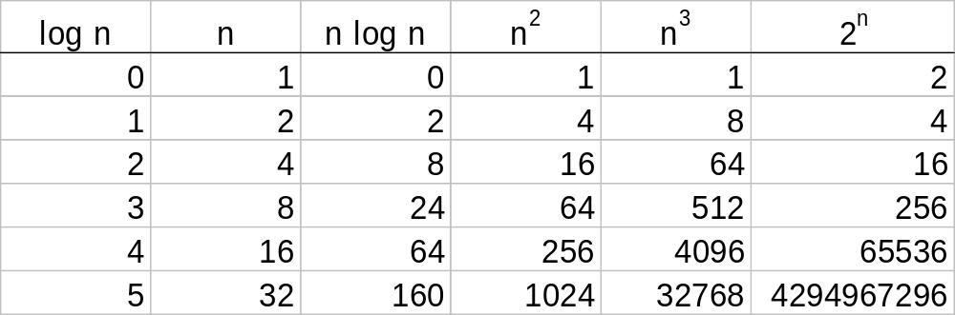
Some Numbers

Slide 10


“Relatives” of Big-Oh
“Relatives” of the Big-Oh
  Ω (f(n)): Big Omega – asymptotic lower bound
  Θ (f(n)): Big Theta – asymptotic tight bound
Big-Omega – think of it as the inverse of O(n)
  g(n) is Ω (f(n)) if f(n) is O(g(n))
Big-Theta – combine both Big-Oh and Big-Omega
  f(n) is Θ (g(n)) if f(n) is O(g(n)) and g(n) is Ω (f(n))
Make the difference:
  3n+3 is O(n) and is Θ (n)
  3n+3 is O(n²) but is not Θ (n²)

Slide 11
More “relatives”
Little-oh – f(n) is o(g(n)) if for any c>0 there is n0 such that f(n) < c(g(n)) for n > n0.
Little-omega
Little-theta
2n+3 is o(n²)
2n + 3 is o(n) ?

Slide 12
Example
Remember the algorithm for computing prefix averages
- compute an array A starting with an array X
- every element A[i] is the average of all elements X[j] with j < i
Remember some pseudo-code … Solution 1
Algorithm prefixAverages1(X):
Input: An n-element array X of numbers.
Output: An n -element array A of numbers such that A[i] is the average of elements X[0], ... , X[i].
  Let A be an array of n numbers.
  for i← 0 to n - 1 do
  a ← 0
  for j ← 0 to i do
  a ← a + X[j]
  A[i] ← a/(i+ 1)
  return array A
Analyze this

Slide 13
Example (cont’d)
Algorithm prefixAverages2(X):
Input: An n-element array X of numbers.
Output: An n -element array A of numbers such that A[i] is the average of elements X[0], ... , X[i].
  Let A be an array of n numbers.
  s← 0
  for i ← 0 to n do
  s ← s + X[i]
  A[i] ← s/(i+ 1)
  return array A

Slide 14
Back to the original question
Which solution would you choose?
  O(n²) vs. O(n)
Some math …
  properties of logarithms:
  log_{b}(xy) = log_{b}x + log_{b}y
  log_{b} (x/y) = log_{b}x - log_{b}y
  log_{b}xa = alog_{b}x
  log_{b}a= log_{x}a/log_{x}b
  properties of exponentials:
  a^{(b+c)} = a^{b}a ^{c}
  a^{bc} = (a^{b})^{c}
  a^{b} /a^{c} = a^{(b-c)}
  b = a ^{log}_{a}^{b}
  b^{c} = a ^{c*log}_{a}^{b}

Slide 15
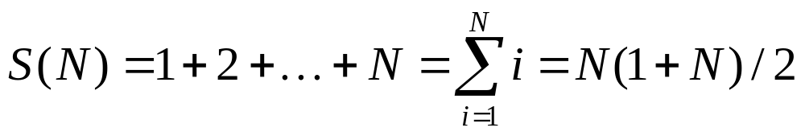
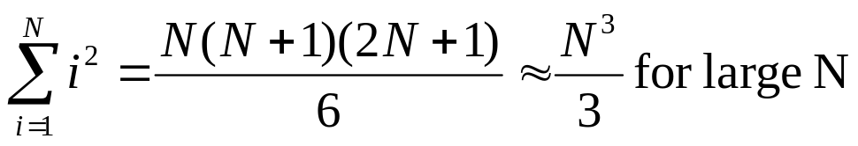
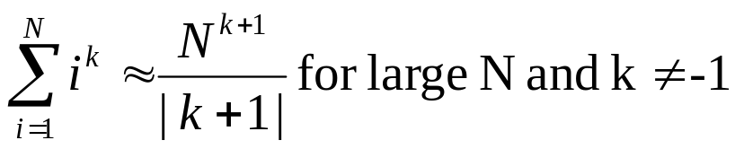
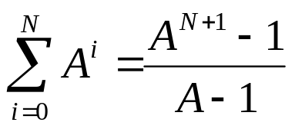
Important Series
Sum of squares:
Sum of exponents:
Geometric series:
  Special case when A = 2
    2⁰ + 2¹ + 2² + … + 2^{N} = 2^{N+1} - 1

Slide 16
Analyzing recursive algorithms
function foo (param A, param B) {
  statement 1;
  statement 2;
  if (termination condition) {
    return;
  foo(A’, B’);
}

Slide 17
Solving recursive equations by repeated substitution
T(n) = T(n/2) + c substitute for T(n/2)
= T(n/4) + c + c substitute for T(n/4)
= T(n/8) + c + c + c
= T(n/2³) + 3c in more compact form
= …
= T(n/2^{k}) + kc “inductive leap”
T(n) = T(n/2^{logn}) + clogn “choose k = logn”
= T(n/n) + clogn
= T(1) + clogn = b + clogn = θ(logn)

Slide 18
Solving recursive equations by telescoping
T(n) = T(n/2) + c initial equation
T(n/2) = T(n/4) + c so this holds
T(n/4) = T(n/8) + c and this …
T(n/8) = T(n/16) + c and this …
…
T(4) = T(2) + c eventually …
T(2) = T(1) + c and this …
T(n) = T(1) + clogn sum equations, canceling the terms appearing on both sides
T(n) = θ(logn)

Slide 19
Problem
Running time for finding a number in a sorted array
[binary search]
  Pseudo-code
  Running time analysis

Slide 20
ADT
ADT = Abstract Data Types
A logical view of the data objects together with specifications of the operations required to create and manipulate them.
Describe an algorithm – pseudo-code
Describe a data structure – ADT

Slide 21
What is a data type?
A set of objects, each called an instance of the data type. Some objects are sufficiently important to be provided with a special name.
A set of operations. Operations can be realized via operators, functions, procedures, methods, and special syntax (depending on the implementing language)
Each object must have some representation (not necessarily known to the user of the data type)
Each operation must have some implementation (also not necessarily known to the user of the data type)

Slide 22
What is a representation?
A specific encoding of an instance
This encoding MUST be known to implementors of the data type but NEED NOT be known to users of the data type
Terminology: "we implement data types using data structures“

Slide 23
Two varieties of data types
Opaque data types in which the representation is not known to the user.
Transparent data types in which the representation is profitably known to the user:- i.e. the encoding is directly accessible and/or modifiable by the user.
Which one you think is better?
What are the means provided by C++ for creating opaque data types?

Slide 24
Why are opaque data types better?
Representation can be changed without affecting user
Forces the program designer to consider the operations more carefully
Encapsulates the operations
Allows less restrictive designs which are easier to extend and modify
Design always done with the expectation that the data type will be placed in a library of types available to all.

Slide 25
How to design a data type
Step 1: Specification
Make a list of the operations (just their names) you think you will need. Review and refine the list.
Decide on any constants which may be required.
Describe the parameters of the operations in detail.
Describe the semantics of the operations (what they do) as precisely as possible.

Slide 26
How to design a data type
Step 2: Application
Develop a real or imaginary application to test the specification.
Missing or incomplete operations are found as a side-effect of trying to use the specification.

Slide 27
How to design a data type
Step 3: Implementation
Decide on a suitable representation.
Implement the operations.
Test, debug, and revise.

Slide 28
Example - ADT Integer
Name of ADT Integer
Operation Description C/C++
Create Defines an identifier with an
undefined value int id1;
Assign Assigns the value of one integer id1 = id2;
identifier or value to another integer
identifier
isEqual Returns true if the values associated id1 == id2;
with two integer identifiers are the
same

Slide 29
Example – ADT Integer
LessThan Returns true if an identifier integer is
less than the value of the second id1<id2
integer identifier
Negative Returns the negative of the integer value -id1
Sum Returns the sum of two integer values id1+id2
Operation Signatures
Create: identifier → Integer
Assign: Integer → Identifier
IsEqual: (Integer,Integer) → Boolean
LessThan: (Integer,Integer) → Boolean
Negative: Integer → Integer
Sum: (Integer,Integer) → Integer

Slide 30
More examples
We’ll see more examples throughout the course
  Stack
  Queue
  Tree
  And more

